Slide 1


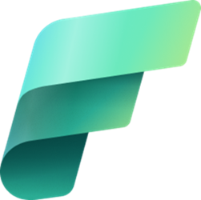
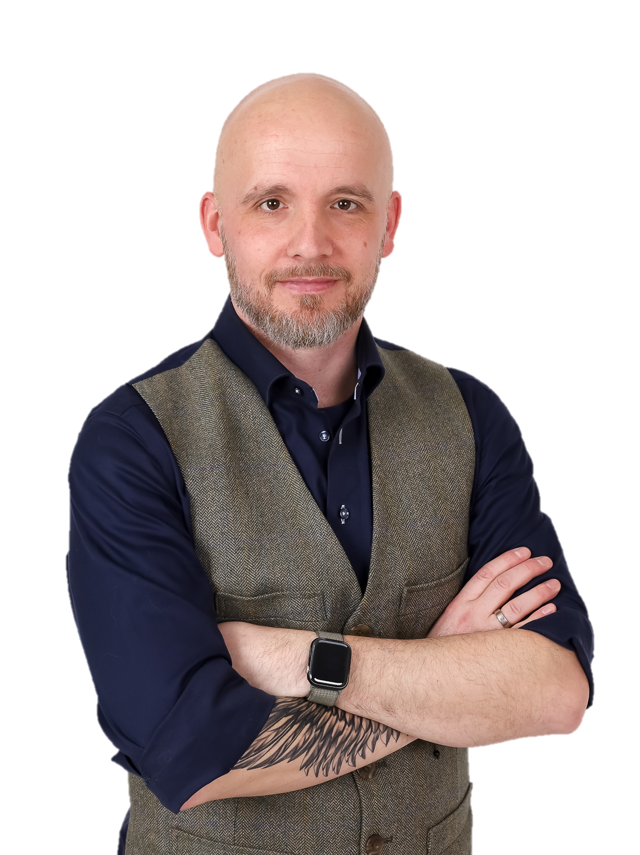
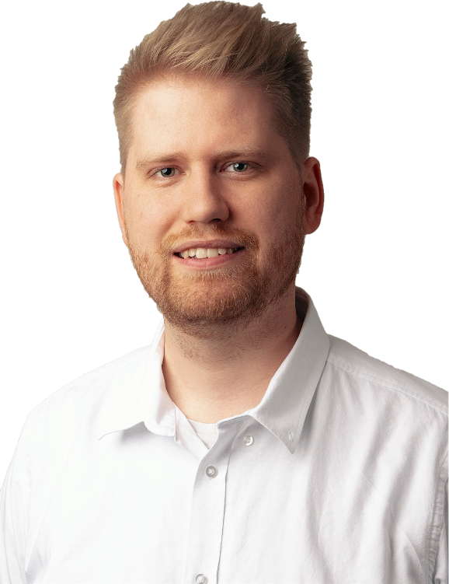
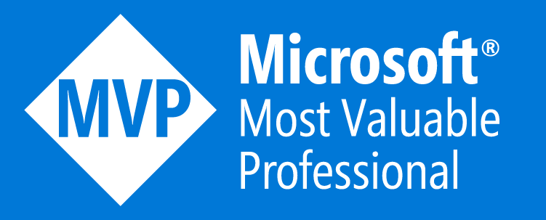
Fabric Labs
Hands-on practice
Brian Bønk Principal Architect
Mathias Halkjær Principal Architect

Slide 2
Agenda
08:00-09:00: Arrival, registration and breakfast 09:00-09:30: Intro to Fabric and the use cases for the platform w/ Brian & Mathias 09:30-10:20: Ingestion of data using Data Pipelines - with hands on labs w/ Mathias 10:20-11:10: Notebooks & Data transformation using Dataflow Gen2 - with hands on labs - w/ Henri & Christian 11:10-11:20: 10 min break 11:20-12:10: Data Warehouse in Fabric - with hands on labs w/ Christian 12:10-13:00: Lunch 13:00-13:50: Data Science in Fabric - with hands on labs w/ Henri 13:50-14:00: 10 min break 14:00-14:50: Real-time analytics - with hands on labs w/ Brian 14:50-15:00: 10 min break 15:00-15:50: Power BI analytics using Direkt Lake - with hands on labs w/ Lars 15:50-16:30: Pespectives, Roll-off and closing

Slide 3

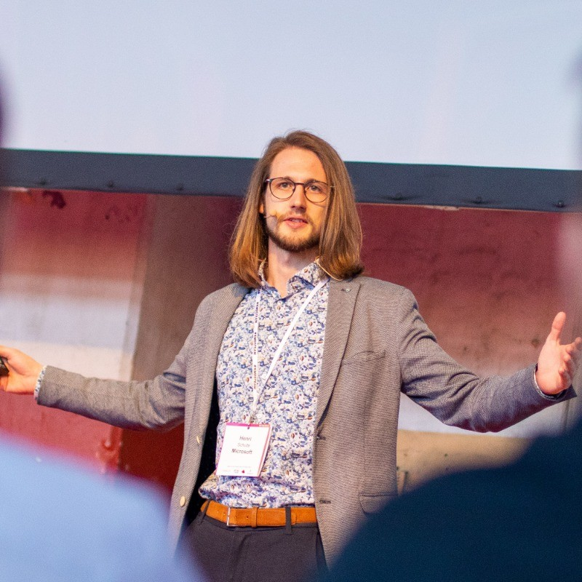
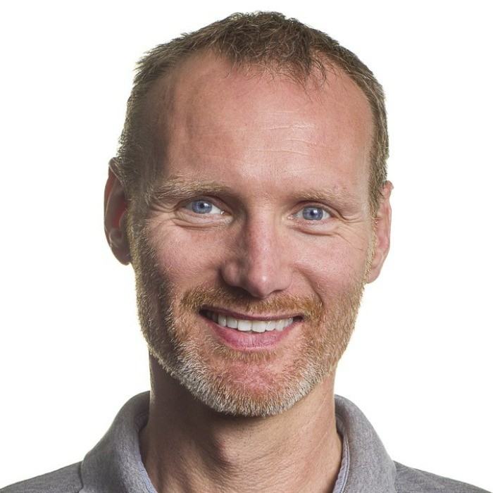
Presenters
Brian Bønk Principal Architect
Mathias Halkjær Principal Architect

Slide 4

General

Slide 5






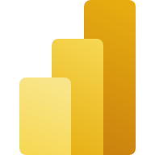



Slide 7
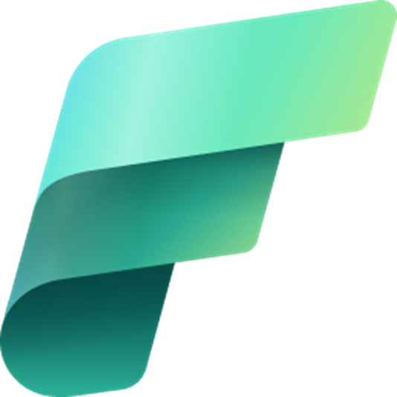
Microsoft Fabric
Data Factory
Synapse Data Engineering
Synapse Data Warehouse
Synapse Data Science
Synapse Real-Time Analytics
Power BI
Data Activator (coming soon)
OneLake
Notes:
Unified Analytics Platform
Lake Centric and Open
Empower every Office user
Pervasive security and governance

Slide 8
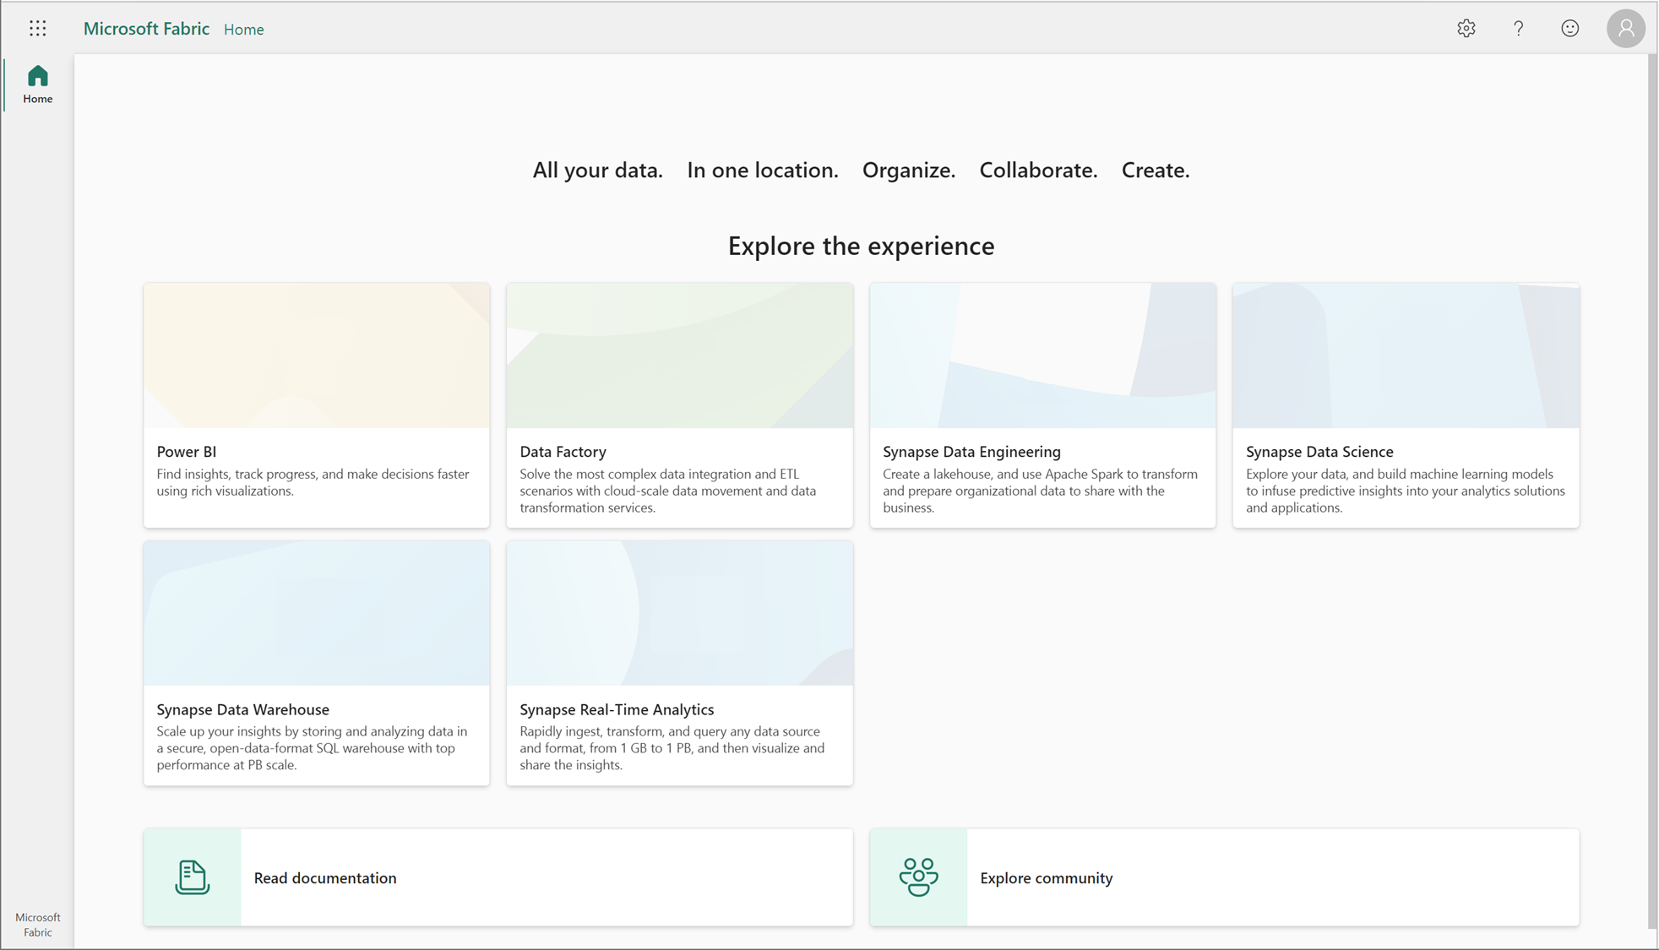
Microsoft Fabric
Notes:
Unified Analytics Platform
Lake Centric and Open
Empower every Office user
Pervasive security and governance

Slide 9

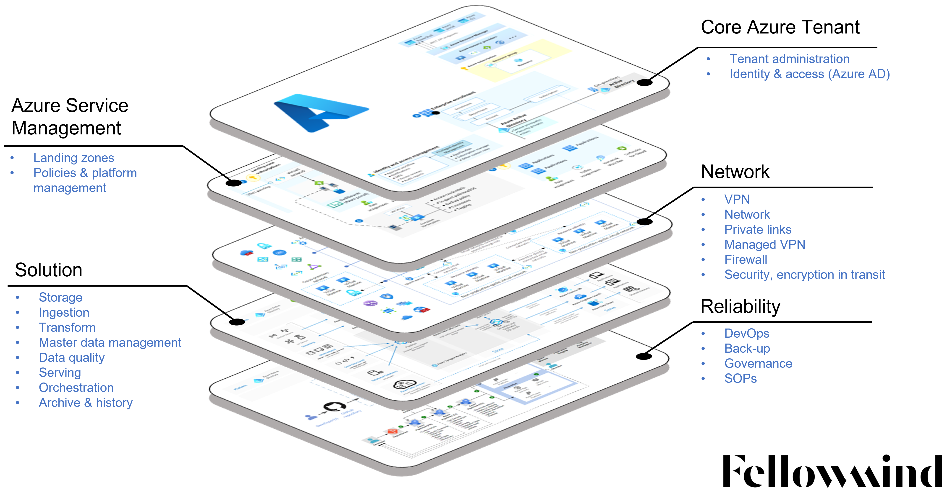
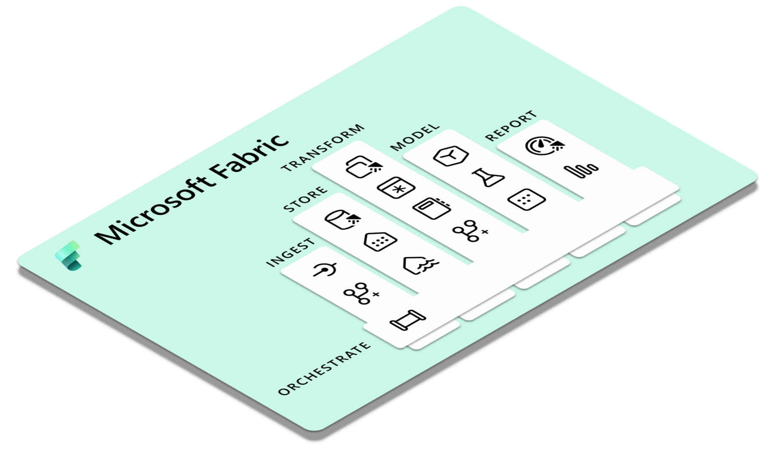
What will happen to Azure Synapse?

Slide 10
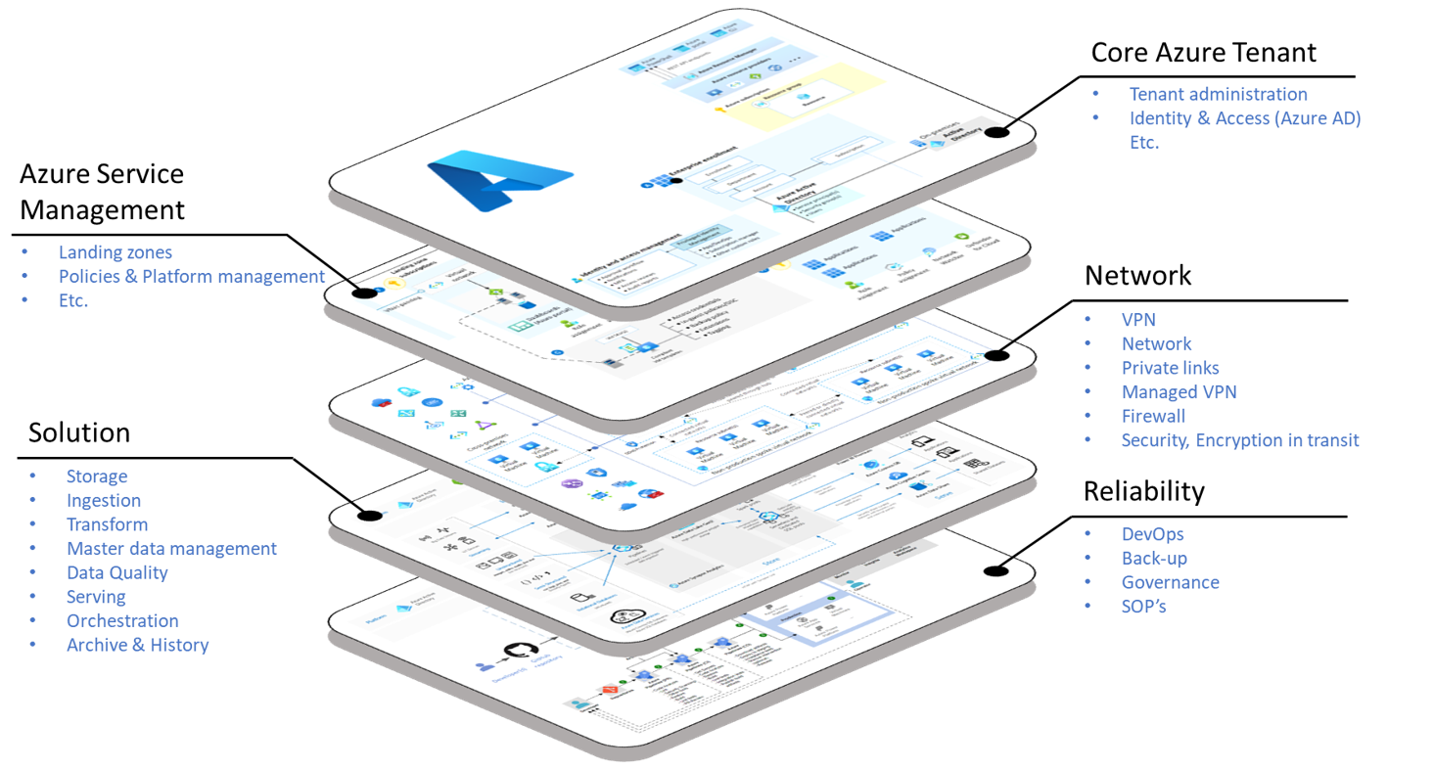
What will happen to Azure Synapse?

Slide 11
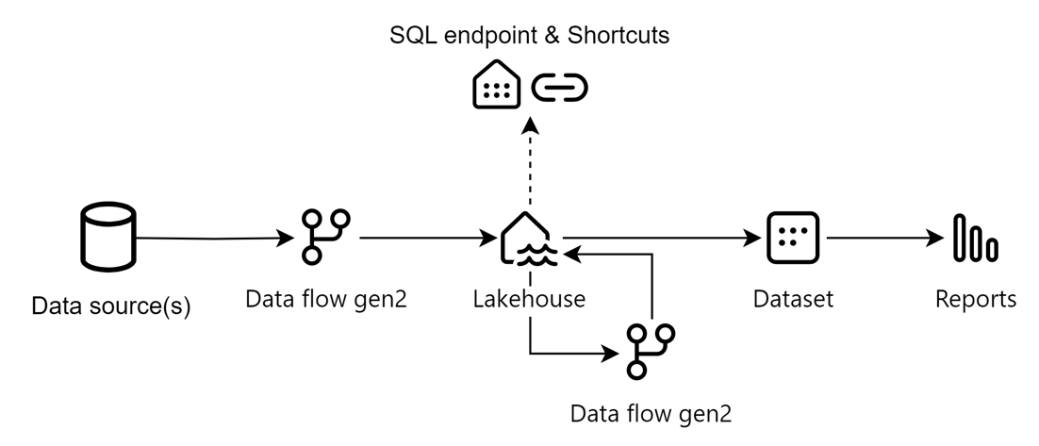
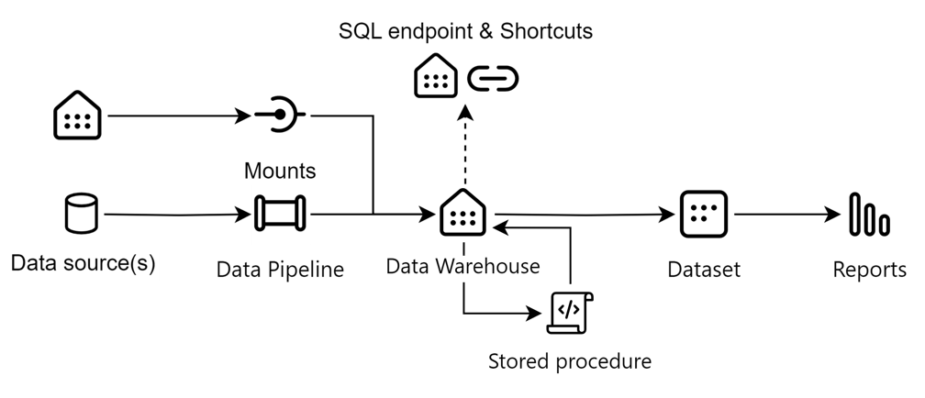
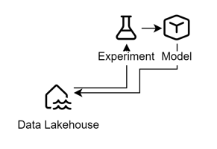
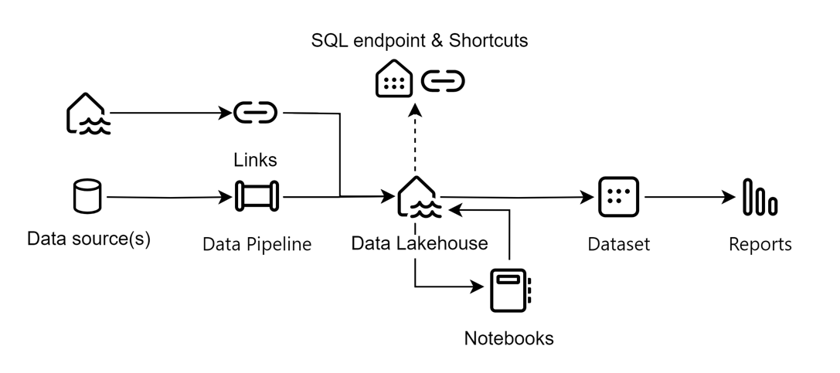
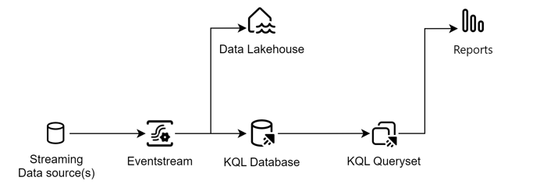
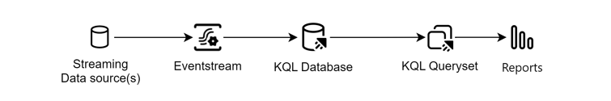
Architecture blueprints

Slide 12















Roles & qualifications
Data Administrator
Lakehouse
Warehouse
Power BI
Data Analyst
Power BI
Paginated
Apps
Metrics
Goals
Data Warehouse Developer
Lakehouse
Warehouse
Pipelines
Data Scientist
Experiments
Models
Notebooks
Data Engineer
Dataflows
Notebooks
Pipelines

Slide 13

Collaboration
ONELAKE
Data Administrator
With OneLake at its core, Microsoft Fabric unifies data disciplines and enhance collaboration across all data professionals.
OneLake both ties together all the tools, experiences and technologies – and by doing so the people working in it.
Never has it been as easy to share ones important and impactful work instantly with the right colleagues.
Data Engineer
Data Warehouse Developer
OneLake
Data Scientist
Data Analyst

Slide 14
Microsoft Fabric
Data Factory
Synapse Data Engineering
Synapse Data Warehouse
Synapse Data Science
Synapse Real-Time Analytics
Power BI
Data Activator (coming soon)
OneLake
Notes:
Unified Analytics Platform
Lake Centric and Open
Empower every Office user
Pervasive security and governance

Slide 15
Organizing OneLake
ONELAKE
OneLake is organized as a Data Lake with containers and a folder structured, automatically created from artifacts in Microsoft Fabric.
A workspace loosely corresponds to a container, a lakehouse/warehouse to a root-level folder with any subsequent folder hierarchy therein.
To make delta tables work properly in Fabric they need to remain at the top level in an artifact.
OneLake
Domains (preview)
Workspaces
Storage artifacts
Tables
Folders (Files)

Slide 16




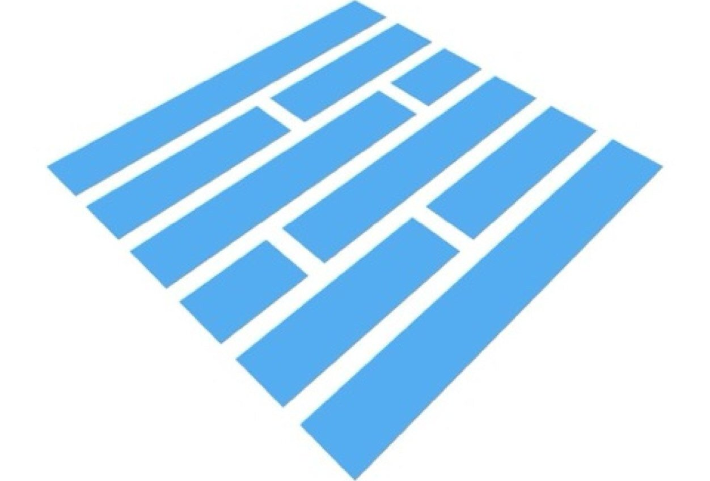


Organizing OneLake
OneLake
ONELAKE
Workspace
Artifact
Tables
Files
Type
Tables
Files
!
No folder structure for tables
Subfolders
Files
(Underlying data)

Slide 17

Enjoy!

Slide 18
Architecture blueprints

Slide 19
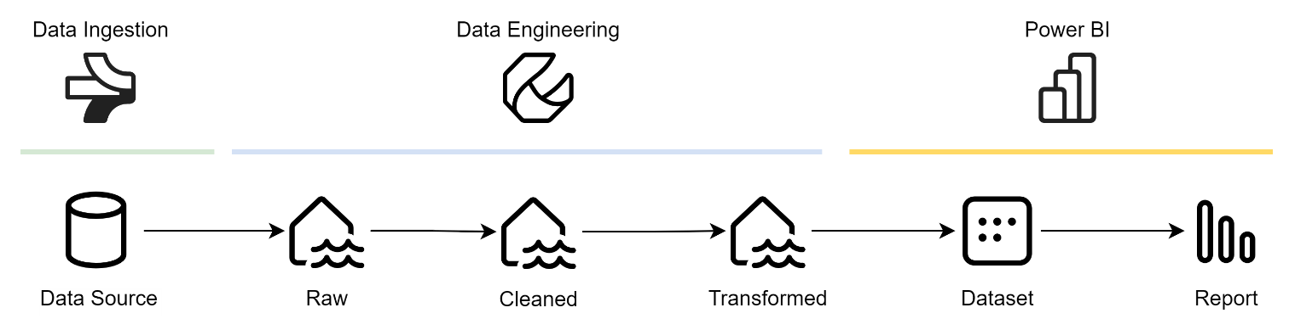
Data Processing Flow
ALL

Slide 20
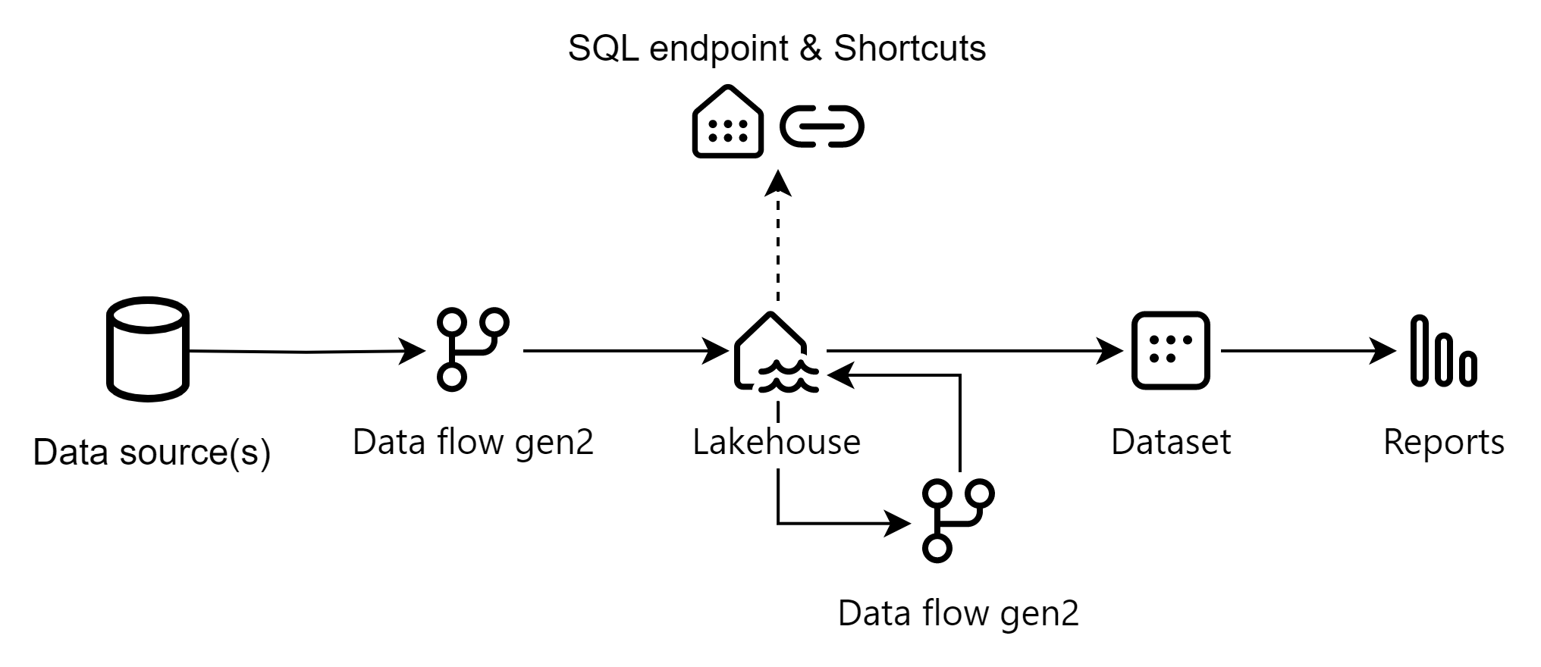
Architecture blueprint
ALL
Simplified Data Platform

Slide 21
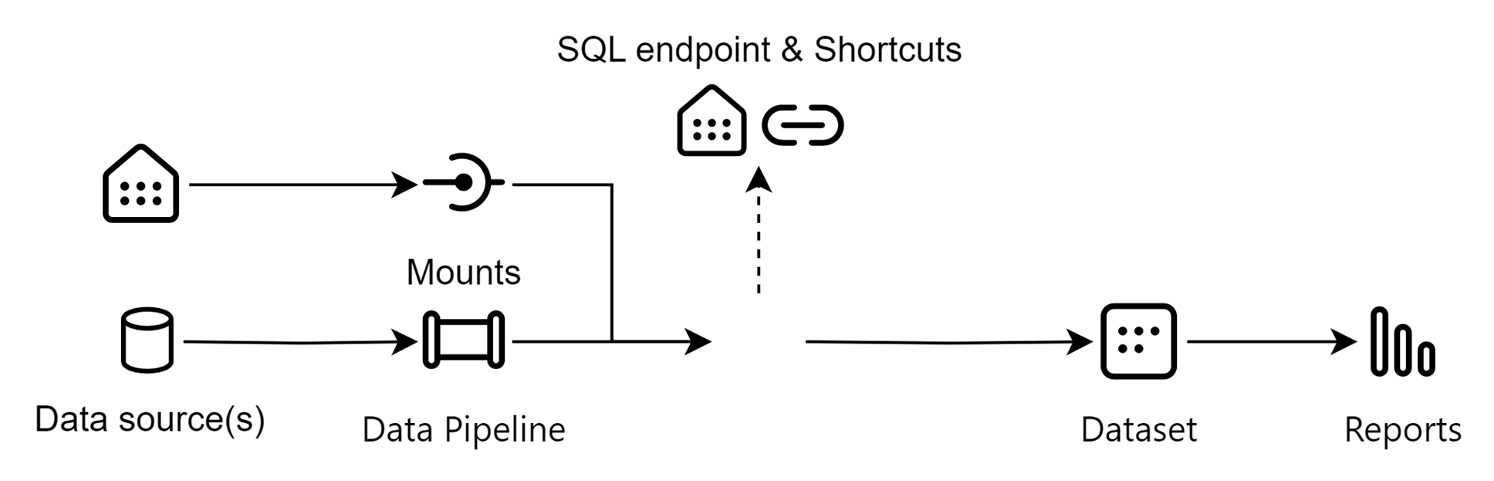
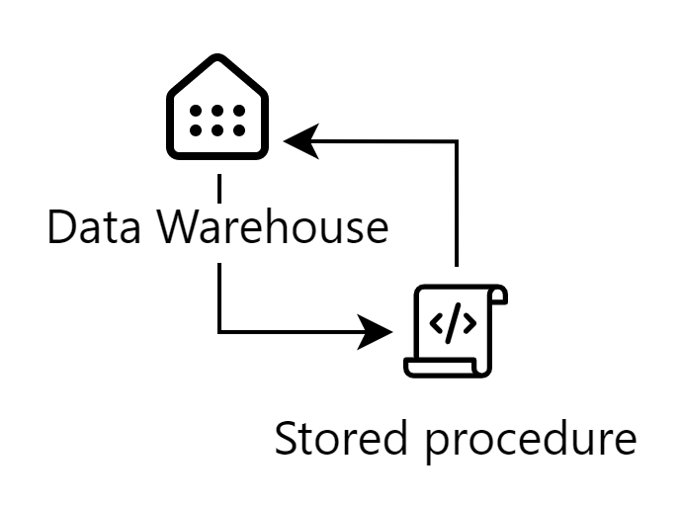
Architecture blueprints
ALL
Modern SQL Data Warehouse

Slide 22
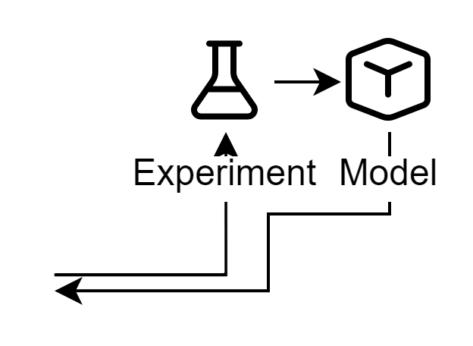
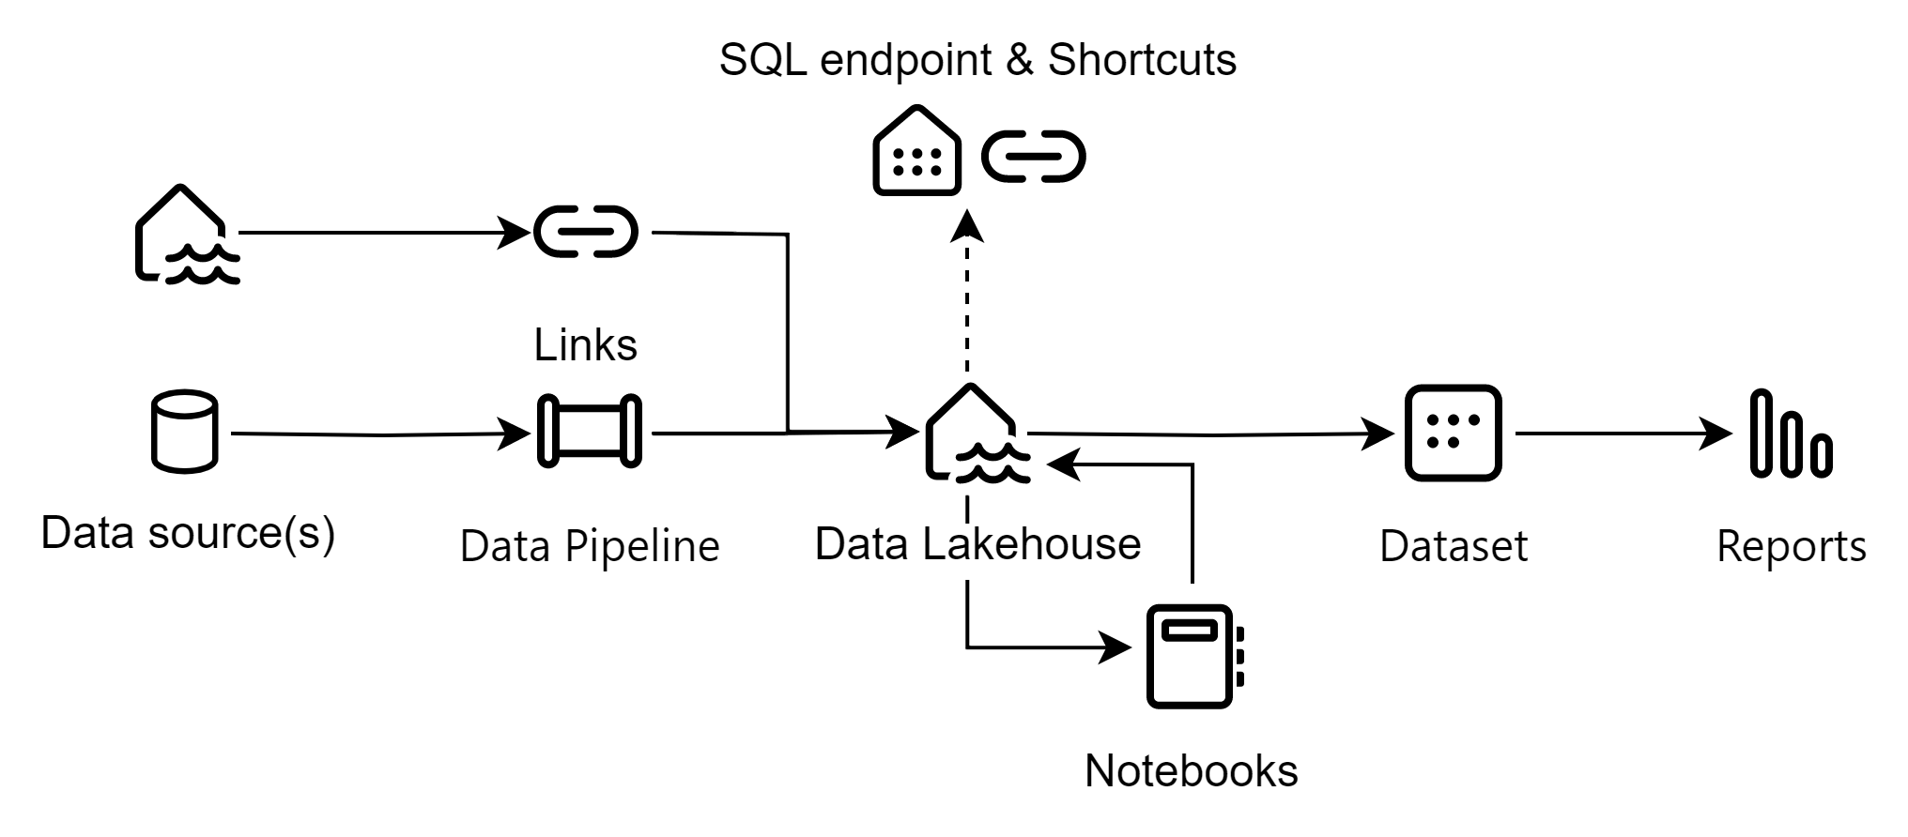
Architecture blueprints
ALL
Data Lakehouse

Slide 23
Architecture blueprints
ALL
Data Lakehouse
+ Machine Learning Workflow
Data Lakehouse

Slide 24
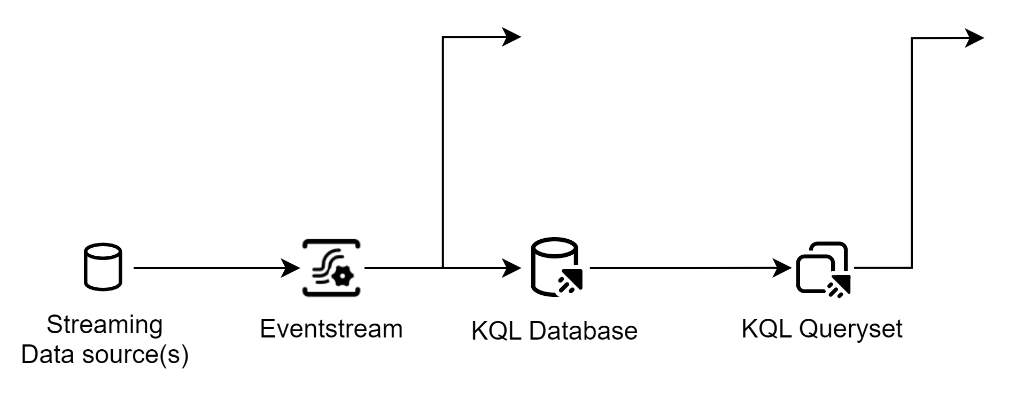
Data Lakehouse
+ Machine learning workflow + Real-Time Analytics
Architecture blueprints
ALL

Slide 25

Questions, ideas, dialogues & comments

